Slide 1
12071 - Traveling mail carrier

Slide 2
Description
A mail carrier needs to deliver letters to multiple places and goes back to the post office to take a rest.
Traveling outside makes him feel tired, so he would like to come up with a shortest path.
Given all distances between every pair of places (including the post office and all destinations), please help the mail carrier figure out the best shortest path, which starts from the post office and ends at the post office.
An additional requirement is that the mail carrier can just go to each place only one time (excluding the starting point, he can go to the start point at the beginning and in the end).

Slide 3
Sample Input
3 there are N places (including the post office)
0 1 2 N*N matrix: Matrix(i,j) = distance between place i and place j
1 0 5
2 5 0
Ａ
1
2
Ｂ
Ｃ
5

Slide 4
Sample Output
8 minimum distance the mail carrier has to travel
(Note: remember to print a '\n' at the end of output.)

Slide 5
Idea
A
B
C
D
A
: 15
2
Ａ
Ｃ
A
B
D
C
A
: 10
5
6
1
3
…
Ｂ
D
4
A
D
C
B
A
: 15

Slide 6
Idea
2
Ａ
Ｃ
5
6
1
3
Ｂ
D
4
AB
ACB
ACBD
ACBDA
A
AC
ACD
ACDB
ACDBA
AD

Slide 7
Idea
2
Ａ
Ｃ
5
6
1
3
Ｂ
D
4
AB
ACB
ACBD
ACBDA
A
AC
ACD
ACDB
ACDBA
AD

Slide 8
Idea
= first visited place
2
X
Ａ
Ｃ
: 0
5
6
A
B
C
D
1
3
fixed
Ｂ
D
4

Slide 9
Idea
= first visited place
2
A
X
Ａ
Ｃ
: 0
5
6
A
1
3
fixed
Ｂ
D
4

Slide 10
Idea
= first visited place
2
A
X
Ａ
Ｃ
: 0
5
6
B
C
D
1
3
fixed
Ｂ
D
4

Slide 11
Idea
= first visited place
2
A
B
X
Ａ
Ｃ
: 1
5
6
B
C
D
1
3
fixed
Ｂ
D
4

Slide 12
Idea
= first visited place
2
A
B
X
Ａ
Ｃ
: 1
5
6
C
D
1
3
fixed
Ｂ
D
4

Slide 13
Idea
= first visited place
2
A
B
C
X
Ａ
Ｃ
: 7
5
6
C
D
1
3
fixed
Ｂ
D
4

Slide 14
Idea
= first visited place
2
A
B
C
X
Ａ
Ｃ
: 7
5
6
D
1
3
fixed
Ｂ
D
4

Slide 15
Idea
= first visited place
2
A
B
C
D
X
Ａ
Ｃ
: 10
5
6
D
1
3
fixed
Ｂ
D
4

Slide 16
Idea
= first visited place
2
A
B
C
D
A
Ａ
Ｃ
: 15
5
6
1
3
fixed
Ｂ
D
4

Slide 17
Idea
= first visited place
2
A
B
X
Ａ
Ｃ
: 1
5
6
C
D
1
3
fixed
Ｂ
D
4

Slide 18
Idea
= first visited place
2
A
B
D
X
Ａ
Ｃ
: 5
5
6
C
D
1
3
fixed
Ｂ
D
4

Slide 19
Idea
= first visited place
2
A
B
D
C
X
Ａ
Ｃ
: 8
5
6
C
1
3
fixed
Ｂ
D
4

Slide 20
Idea
= first visited place
2
A
B
D
C
A
Ａ
Ｃ
: 10
5
6
1
3
fixed
Ｂ
D
4

Slide 21
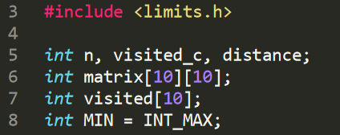
Global variables
n: n places
matrix: distance matrix
visited: already visited places
visited_c: number of already visited places
distance: path distance
MIN: minimum distance

Slide 22
Main function
int main(void) {
scanf("%d", &n);
for (int i = 0; i < n; i++) {
visited[i] = 0;
for (int j = 0; j < n; j++) {
scanf("%d", &matrix[i][j]);
}
}
visited[0] = 1;
visited_c = 1;
distance = 0;
dfs(0);
printf("%d\n", MIN);
return 0;
}
1. Load input data
2. Initialize variables
3. Recursive
4. Output

Slide 23
Recursive function
int dfs(int cur) {
if (visited_c == n) {
// All visited.
if (distance + matrix[cur][0] < MIN)
MIN = distance + matrix[cur][0];
}
for (int j = 0; j < n; j++) {
if (!visited[j]) {
visited[j] = 1;
visited_c++;
distance += matrix[cur][j];
dfs(j);
visited[j] = 0;
visited_c--;
distance -= matrix[cur][j];
}
}
}
Recursion termination
Condition: all places are visited
update minimum distance
2
2. For all remaining and unvisited places
Visit it and recursive
Undo previous step not to affect the following steps
Ａ
Ｃ
5
6
1
3
Ｂ
D
4

Slide 24
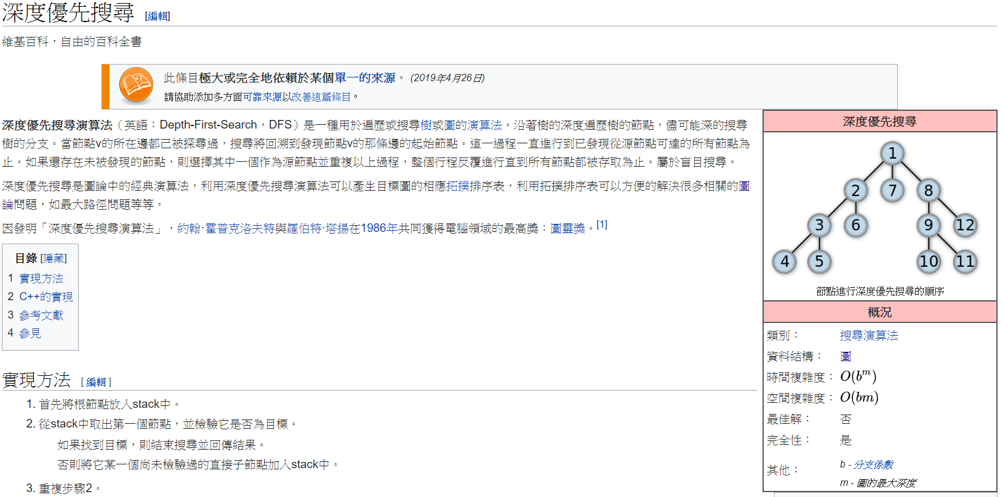
DFS(也可看此介紹: https://reurl.cc/YlR6nx)

